Slide 1
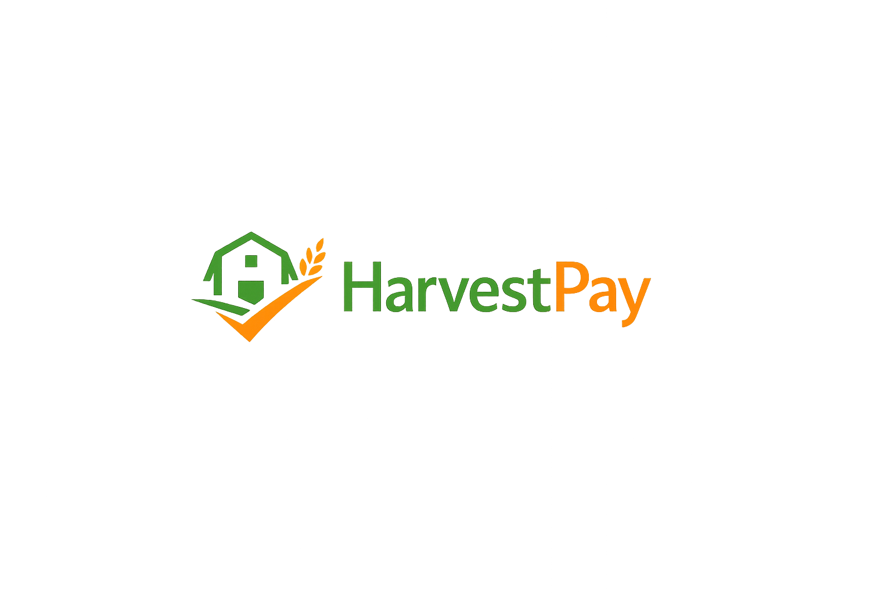

PREPARED FOR: VINOGRADNIŠTVO MARIBOR
HARVESTPAY SOLUTIONS
Digital Logistics &
Automated Payroll
Transforming viticulture operations with secure, IoT-driven data capture and real-time financial tracking.

Slide 2






PROBLEM AREA
CURRENT SITUATION
Administrative Lag
Human Error
Zero Visibility
Manual transcription of paper reports to Excel spreadsheets takes time and slows down the whole process.
Unreadable handwriting or lost paper records directly result in inaccurate payroll calculations, leading to disagreements with seasonal workers.
Executive management do not have real-time information about worker performance, harvest progress, or total output.

Slide 3
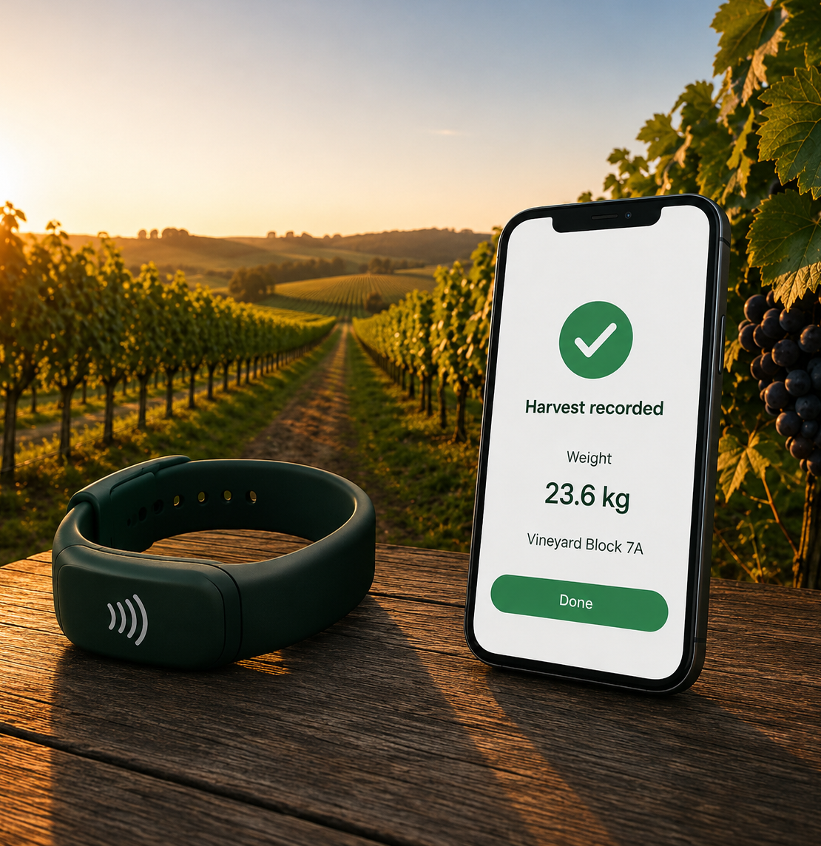

PROJECT IDEA
OUR SOLUTION
HarvestPay
NFC Wristbands for workers
Mobile scanning at weigh stations
Automatic data transfer to cloud
Manager dashboard with real-time overview

Slide 4




PROJECT GOAL and BENEFITS
Goal: Replace manual processes with a modern, reliable and transparent solution.
Faster data collection and processing
Less errors and higher data accuracy
Fair and transparent payments
Better overview for managers

Slide 5
Project objectives
70%
99%
€60K
LESS PAPEWORK
PAYROLL ACCURANCY
TOTAL BUDGET CEILING
By using NFC scanning, we eliminate manual paper sheets, saving managers hours of evening data entry. We deliver this within a strict €60,000 budget, making digital transformation affordable without compromising quality. Finally, our system guarantees 99% accuracy in payroll calculations, ensuring fair pay for every worker and eliminating costly financial discrepancies.

Slide 6
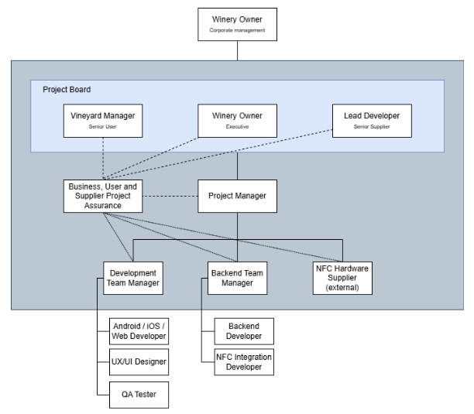
PROJECT GOVERNANCE FRAMEWORK
Our structure follows PRINCE2 to ensure clear accountability. The Project Board is our core: the Winery Owner acts as Executive, the Vineyard Manager as Senior User, and the Lead Developer as Senior Supplier .
As Project Managers, we coordinate the development team, Backend team and the hardware supplier.

Slide 7
PROACTIVE RISK MANAGEMENT (RPN)
We analyzed 12 potential threats. The highest priority was given to risks with a high impact and a low probability of detection
 |  | Consequence
 |  | 1 - Negligible | 2 - Minor | 3 - Moderate | 4 - Major | 5 - Catastrophic
Likelihood | 5 - Almost certain
 | 4 - Likely |  |  | [R2] | [R1]
 | 3 - Possible |  |  | [R3]; [R4]; [R8]; [R12] | [R5]; [R7]
 | 2 - Unlikely |  |  | [R6] | [R11] | [R10]
 | 1 - Rare |  |  |  |  | [R9]
[R1] Lack of internet connectivity in the vineyard | 16
[R2] NFC wristband scanning failure | 12
[R3] Incorrect worker profile data | 9
[R4] Manual entry error of harvested weight | 9
[R5] Delay in software development | 12
[R6] Budget overspend | 6
[R7] Low user acceptance | 12
[R8] Hardware supplier delivery issue | 9
[R9] Cloud service outage or data loss | 5
[R10] Data protection / GDPR issue | 10
[R11] Incorrect payroll calculation | 8
[R12] Key team member unavailable | 9

Slide 8
PROACTIVE RISK MANAGEMENT
Identified risk | Risk owner | Date | Risk description | Probability | Risk response actions
Lack of internet connectivity in the vineyard | Project Manager |  | Vineyards are located in rural areas with limited mobile network coverage. Weak or unstable internet connection may prevent real-time synchronization of harvest data. Data is only stored locally, risking loss if the device is damaged or lost before syncing. | High | 1. Implement offline mode with local storage on device. 2. Synchronize automatically when connecticonditions.on is restored. 3. Test app in low-signal
NFC wristband scanning failure | NFC Hardware Supplier |  | NFC wristbands may not be scanned correctly due to hardware incompatibility, damaged tags, or reading errors, causing delays in worker identification. | High | 1. Test multiple wristband types. 2. Provide winery with verified supplier.
Delay in software development | Project Manager |  | Development tasks may take longer than planned due to integration problems or limited resources, which may delay testing and final delivery before the harvest season. | Medium | 1. Use phased planning. 2. Monitor milestones and prioritize core features. 3. Apply schedule tolerance of one to two weeks if necessary.

Slide 9
PROJECT PLAN
Analysis and
Design
Testing
Monitoring and
support
Initiation
and planing
Development
Deployment and
training
Project Closure
Total Duration: 4 Months (Development), + 3 Months (Monitoring and support)

Slide 10
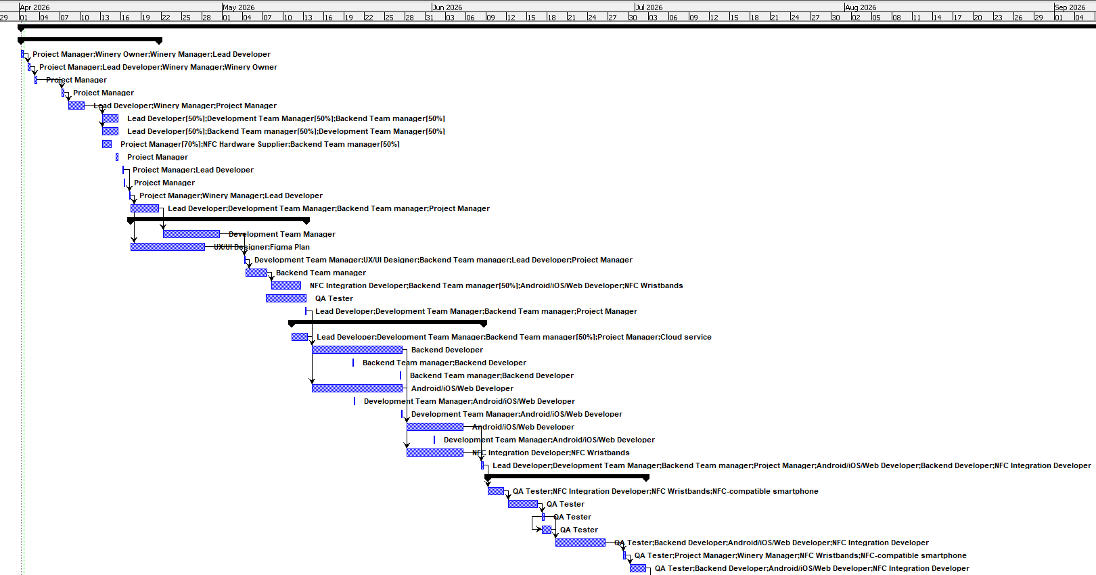
PROJECT PLAN

Slide 11


PROTECTING YOUR INVESTMENT
Our project tracking allows us to evaluate the impact of an unexpected delay and prevent budget overruns. In a recent scenario simulation regarding a critical path delay:
The Threat: A 3-days delay on the critical path.
No intervention: The delay is absorbed by the available time reserve at the end of the project. No additional costs.
Costly Alternative: Onboarding external resources (1660€ cost, within budget).
Result: Deadline preserved, budget unchanged (60,000€) and backup recovery option available.

Slide 12
ESG & COMPLIANCE INTEGRITY
Environmental Sustainability: HarvestPay digitizes the entire supply chain entry point, eliminating over 500kg of paper waste per harvest season and reducing associated administrative carbon footprints.
Labor Rights & Fair Pay: By providing an immutable, digital record of every bucket picked, we protect vulnerable seasonal workers from wage exploitation, fully aligning with EU Agriculture 4.0 labor directives.
Data Governance: Enterprise-grade cloud encryption ensures that all worker identity and payroll data is handled in strict accordance with GDPR, protecting winery owners from regulatory liabilities.

Slide 13

Let's build the future
of viticulture.
Floor open for technical and commercial Q&A.
HarvestPay Solutions
Adam Hronec & Bohdan Shevchenko
contact@harvestpay.solutions

